Slide 1

Custom shoes system
Course Code : SWE 321
Assessment: Project
Semester / Year: Winter 2025
Last version: 4/May/2025
Name: Abdulrhman alyousef ID: 444101277
Name: Abdullah Aloraini ID: 444101533
Name: Mohammed Aloraini ID: 444101372
Name: Bassam Alhwarini ID: 444101172
Name: Saad Alqarni ID: 444102880

Slide 2
Introduction
Custom shoes Co. Ltd. focuses on making custom shoes for their Seattle customers.
Their desire is to sell shoes through a self-service web interface which will bring them into the new global economy.
Purpose
The purpose of the custom shoes system is: to enable Custom Shoes Co. Ltd. to expand their business by offering custom-made shoes through an easy to-use online platform.
Why is it useful?
Customers can design and order custom shoes online without visiting a physical store.
By offering online ordering, the company can reach customers beyond Seattle, expanding their market.
First-time users can order a measurement kit to ensure their shoes fit perfectly

Slide 3
Problem domain
Absence of Market Representation: Clients outside Seattle do not have an easy way of placing orders.
Measurement procedure is tedious: It takes considerable time to send and receive measurement kits.
Order and Payment Processing: Increasing incidence of errors due to manual order and payment processing.
Solution
Creation of a website where:
Customers are able to select the style, make modifications, and place an order for a pair of shoes from the comfort of their home.
A kit is sent out for measuring to prospective clients.
All entered orders are stored in the system automatically
Receipt of payment is done through the website

Slide 4

Functional Requirements 1- The System shall allow the customer to register into the system. 2- The system shall allow users to customize the shoe’s features, including. Dye colors and finishes. Patterns and stitched designs. Laces, buckles, and other accessories. 3- The system shall allow the customer to make payment. 4- The System shall allow the Customer to Request measurement kit. 5- The system shall allow users to input their shoe size manually from the provided measurement kit. 6- The system shall provide users with the ability to track the delivery status of their orders.

Slide 5

Non-Functional Requirements
Performance:
The system shall support at least 500 simultaneous users without lagging.
(We will implement a cache server.)
Security:
The system shall ensure secure management of personal information (email, password, address). (We will apply advanced security tools Like OWASP ZAP.)
Usability:
The system shall allow users to customize a shoe in no more than 9 clicks.
(We will Lunch a Beta version of the system to ensure usability.)
Availability:
The system shall be available 99.13% of the time.
(We will implement a backup server.)

Slide 6
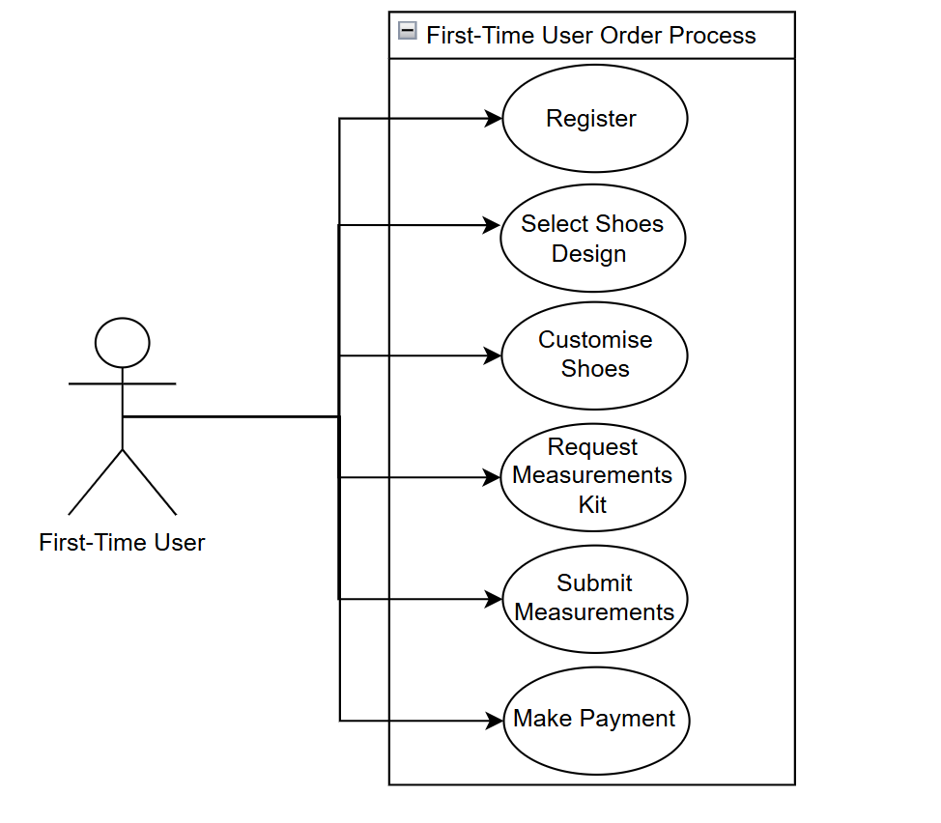
Scenario
use case diagram
- New Customer Order:
A registered user visits the website, selects a shoe, choose stitched-on patterns, dye colors and finishes, laces and buckles, and requests a measurement kit.
After sending back the kit and provide the measurements, they complete the order and pay online.
Input: Shoe design, customization, address for measurements kit, E-mail, Password, Address, and Payment information.
Output: Order confirmation, payment receipt, delivery status of the shipment.

Slide 7
Challenges
Design: How to make the website more attractive.
Customization Flexibility: Letting user to modify shoes effortlessly.
Security Risks: Safeguarding customer data as well as payments.
Shipping & Tracking: Tracking and dispatching packages internationally
Portability: To make the system available for different operating systems

Slide 8
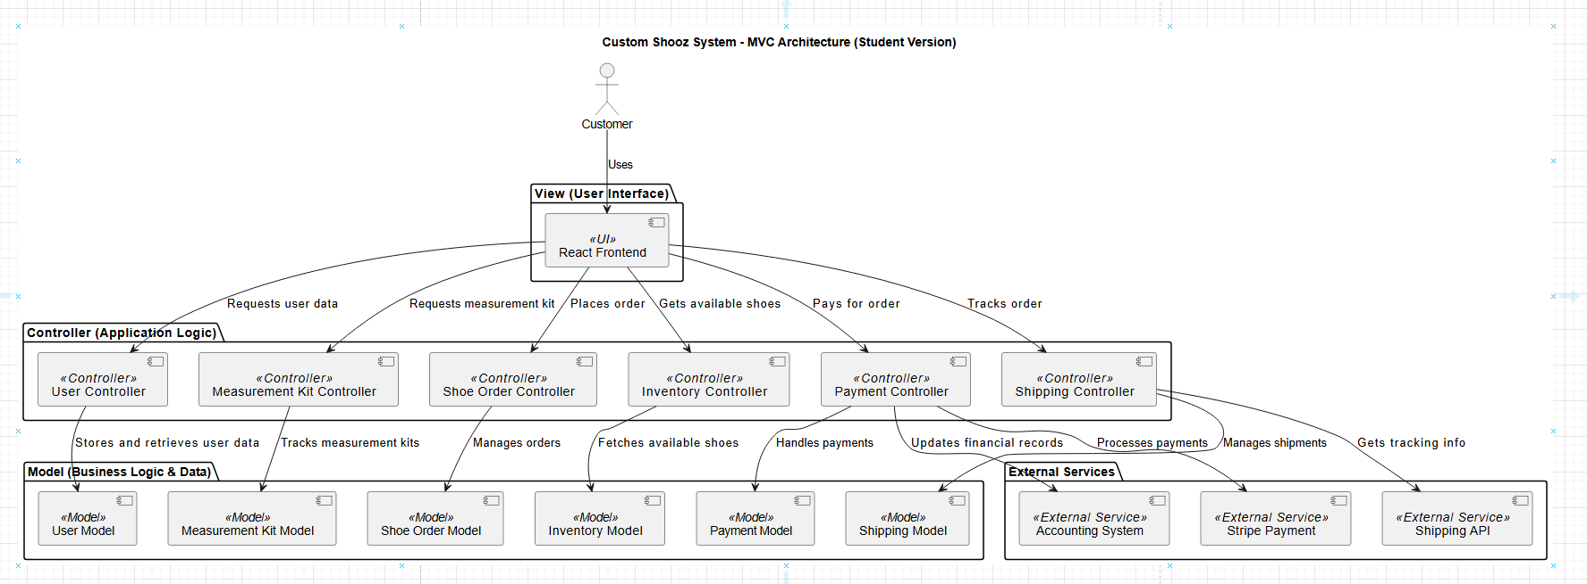
System Architecture
Design decisions: Structure
The system follows the MVC (Model-View-Controller) architecture
Frontend: Built using React.js to provide an interactive and dynamic user interface.
Backend: Developed with Express.js to handle business logic and API requests.
Database: Uses PostgreSQL for structured data storage
Why did we choose MVC ?
1- Separation of Concerns
2- Ease of Maintenance and Scalability
3- Integration with External Services
.

Slide 9
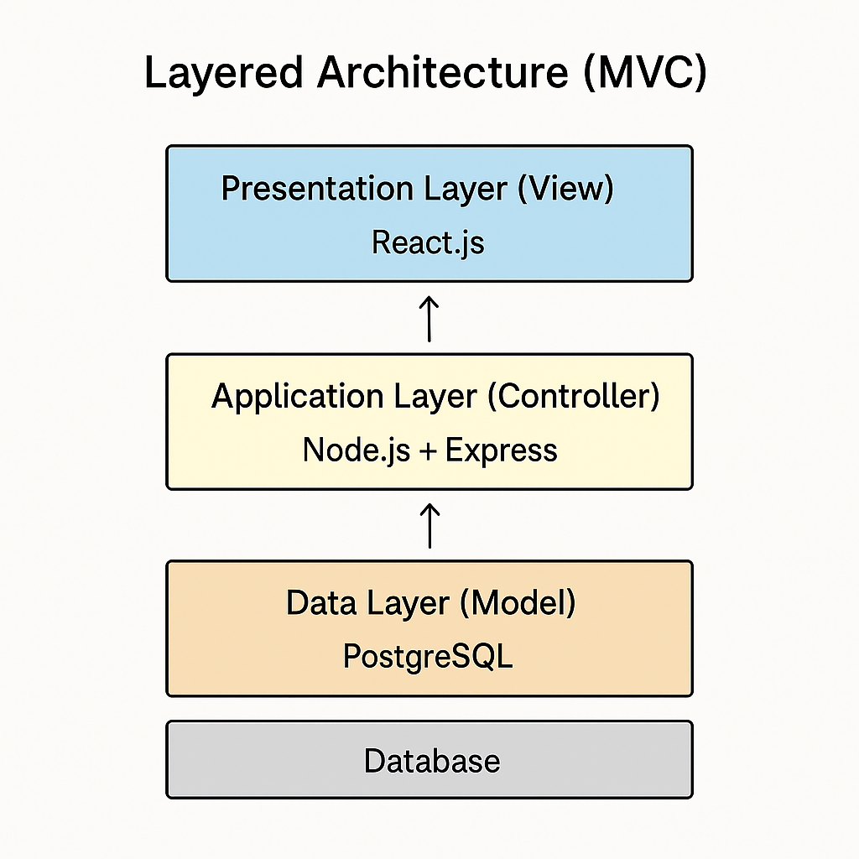
Architectural Style
The Custom shoes System follows a Layered Architecture based on the Model-View-Controller (MVC) pattern.
Justification for Choosing Layered Architecture:
1- Separation of Concerns:
The system is divided into three layers:
Presentation Layer (View): Handles user interaction through a web interface.
Application Layer (Controller): Manages business logic, order processing, and validation.
Data Layer (Model): Stores and retrieves information from the database.
2- Ease of Maintenance and Scalability:
Changes in the user interface do not affect the business logic, making UI updates straightforward.
The backend can scale independently, handling increased user traffic efficiently

Slide 10

Alternative Architectural Style
Alternative Architectural Style Considered: Microservices
this style was not selected due to the following reasons:
Increased Complexity: Managing multiple services requires additional infrastructure, such as API gateways
Higher Overhead: Each microservice would require independent deployment and monitoring

Slide 11
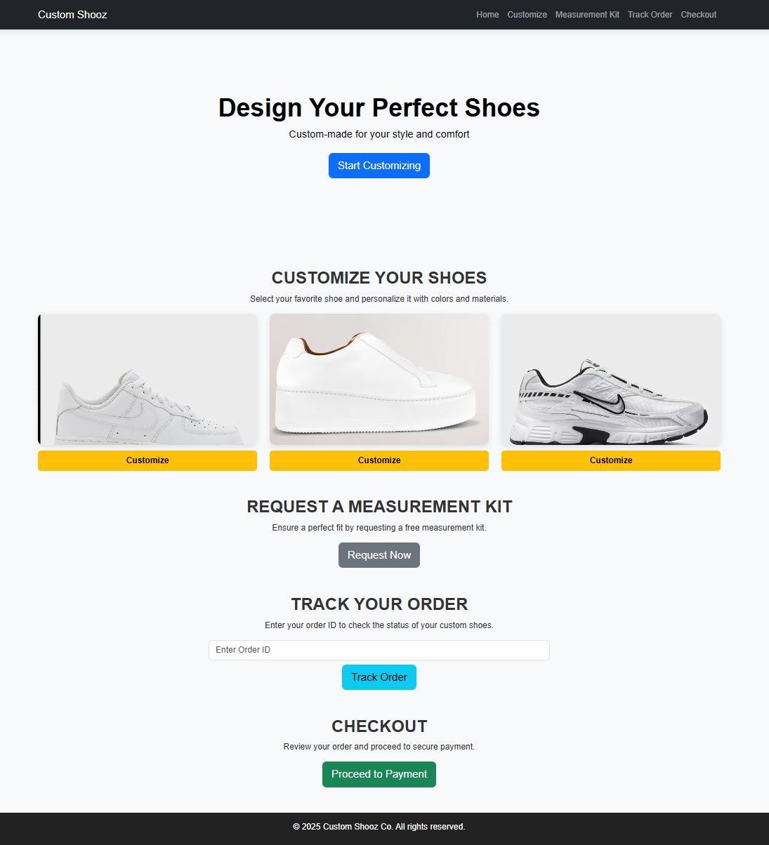
A simple User Interface

Slide 12
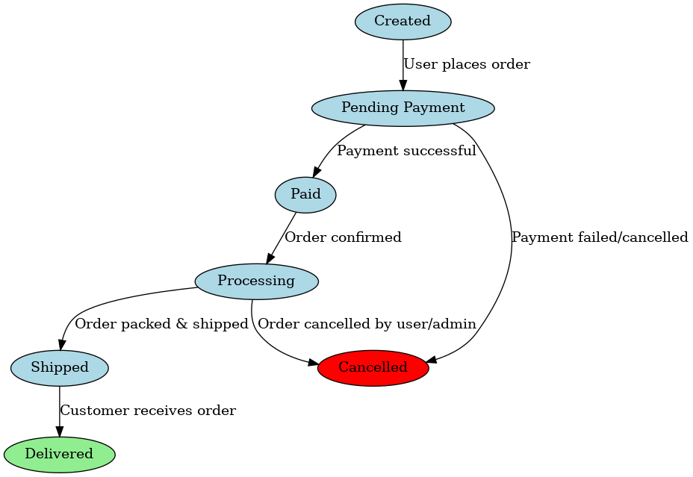
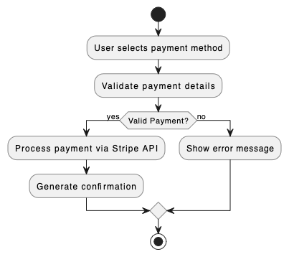
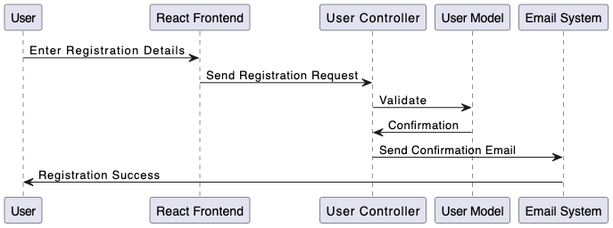
Dynamic model
State diagrams for orders
Activity diagram for payment processing
Sequence diagram for user registration:

Slide 13
Implementation Considerations
The system follows the MVC architecture, implemented with simple and widely used tools to make development easier.
Layer | Tool / Framework | Purpose
Frontend | React.js | Building interactive web pages
Backend | Express.js (Node.js) | Handling API requests and business logic
Database | PostgreSQL | Storing user, order, and payment data

Slide 14
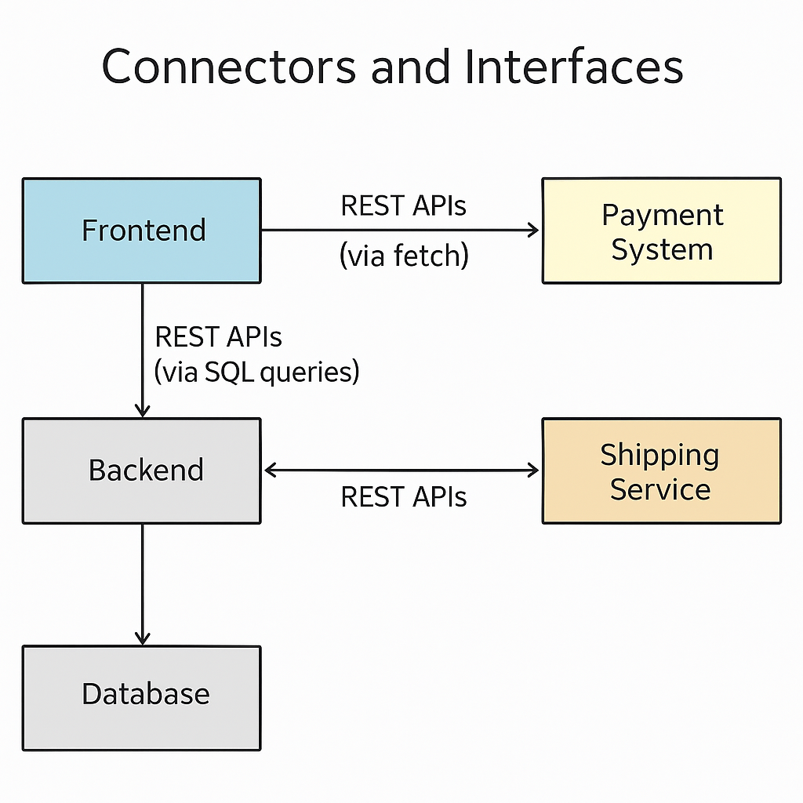
Implementation Considerations

Slide 15
Implementation Considerations
Simple Algorithms and Patterns Used
Purpose | Description
Input Validation | Checks for valid data ( correct shoe size or email)
Customization Matching | Matches measurements to shoe templates
Order Confirmation | Sends confirmation email
Queue Simulation | Uses JavaScript setTimeout to simulate processing delays

Slide 16
Testing Methods and Tools
Testing Type | Tools / Methods Used
Security Testing | OWASP ZAP to scan for security flaws
Unit Testing | Jest (JavaScript testing framework)
Integration Testing | Manual and Postman test of API flow
Performance Testing | Basic tests with browser dev tools

Slide 17
Future Considerations
Scalability and Performance Improvements
Enhance database performance through indexing and partitioning.
Security and Payment Enhancements
Support additional payment methods.
Implement multi-factor authentication (MFA) for enhanced security.
Mobile Application Development
Develop a mobile application for iOS and Android.
Enable push notifications for order updates and promotions.
Global Expansion
Support multiple currencies and localized payment methods.
Implement multi-language support and ensure compliance with regional regulations.
Customer Feedback and Usability Improvements
Establish a feedback system for feature suggestions.
Conduct regular usability testing and A/B testing.

Slide 18
Thank you for listening!

